Slide 1
Adding Practical Security to Your
Introduction to Computers Course (or CTI 120)
Mark Ciampa
Western Kentucky University
mark.ciampa@wku.edu

Slide 2
You Are Here Because . . .
You teach an Introduction to Computers class and are considering adding material on practical security
You want to pick up a few tips to be more secure
You enjoy being scared out of your wits by the latest attacks and our inability to defend ourselves
You want to look respectable with your colleagues by attending at least one session today
You need a strong Wi-Fi signal so you can update your Facebook page
You are hiding from your Cengage book rep and you know that they never go to any of these sessions

Slide 3
Cut Right To The Chase
Things are really bad in security
Users are still confused about security
Our students want to learn practical security
But schools are not teaching practical security
We can teach practical security in our Intro courses
Here’s how we can teach practical security

Slide 4
Cut Right To The Chase
Things are really bad in security
Users are still confused about security
Our students want to learn practical security
But schools are not teaching practical security
We can teach practical security in our Intro courses
Here’s how we can teach practical security

Slide 5
Worst Data Breaches Last 15 Months
Organization | Number of Customers
Premera | 11 Million
Staples | 1.6 Million
Community Health Systems | 4.5 Million
South Korea | 40 Million
Home Depot | 109 Million
JP Morgan Chase | 83 Million
Ebay | 152 Million
Anthem | 105 Million

Slide 6
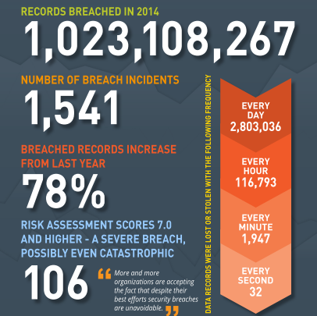

Slide 7
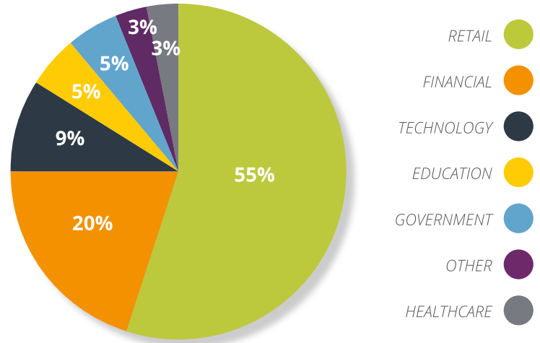

Slide 8
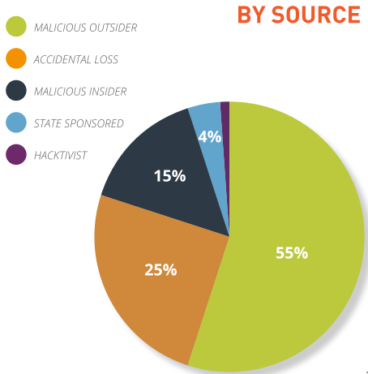
Source

Slide 9
Anthem Data Breach
Stolen personal data from health insurer Anthem very lucrative
Typical stolen payment cards sell on black market for $1
Health insurance credentials sell for $20
Complete identity-theft kit containing comprehensive health insurance credentials sell for $1,000 each
Attackers use identity information (birth dates, Social Security numbers, addresses, employment information, income, etc.) to open new credit accounts on an ongoing basis rather than exploiting just one account until it canceled
Also key pieces of data stolen can be used to access financial records
In 2014 healthcare providers and payers reported a 60% increase in detected incidents resulting in financial losses increased 282% over 2013

Slide 10
TurboTax
TurboTax temporarily suspended transmission of state e-filed tax returns in response to complaints from consumers who found criminals had already claimed a refund in their name
Criminals use stolen identity information to file fraud
Compromised TurboTax accounts sell for .0002 bitcoins (4 cents)

Slide 11
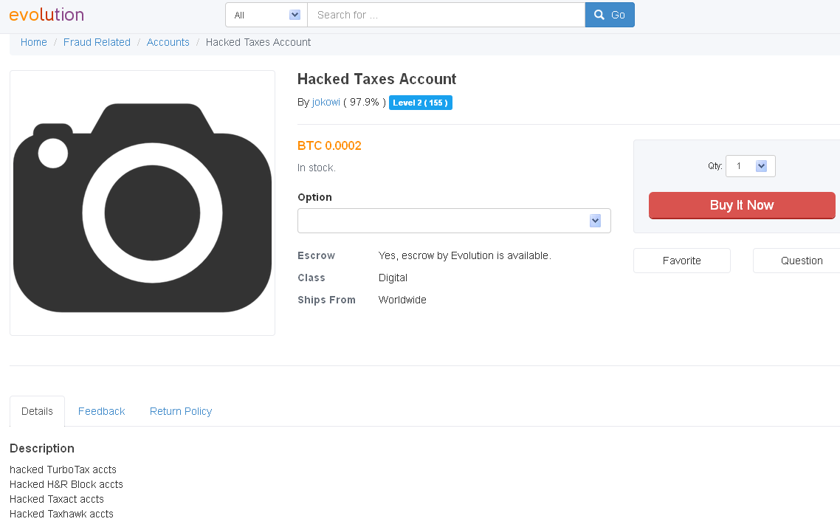

Slide 12
Carbanak
Most cybercrime targets consumers and businesses, stealing account information like passwords and other data that then lets thieves cash out hijacked bank accounts or create fake credit/debit cards
Group now specializes in breaking into banks directly and then use ways to funnel cash from the financial institution itself
Carbanak deployed malware via phishing scams to get inside of computers at 100+ banks and steal between $300 million to $1 billion

Slide 13
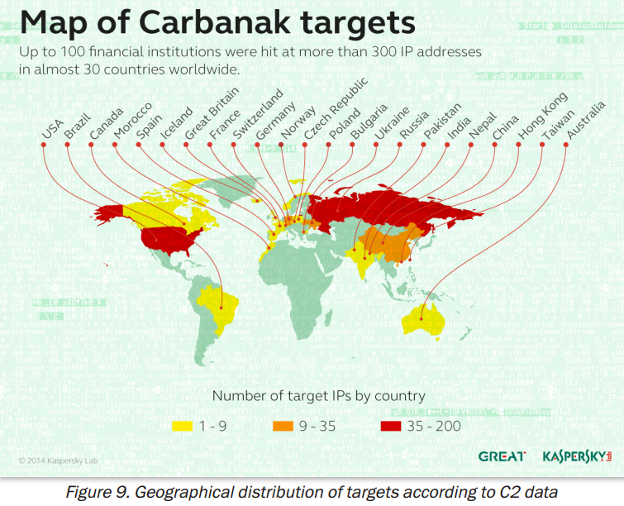

Slide 14
Sony Data Breach
Email and records of 6,500 employees stolen in 100TB data
Thousands of passwords in clear text documents (Password Lists.xls & YouTube Login Passwords.xlsx)
Accounts to Facebook, MySpace, YouTube, Twitter, Lexis/Nexis, Bloomberg, Sony servers, collaboration services
Prevented theatre release of movie The Interview
Will cost Sony $100 million

Slide 15
Antivirus Misses By Top 4 AV Vendors
Time | Malware Missed
1 hour | 70%
24 hours | 34%
7 days | 28%
1 month | 7%
6 months | 100%

Slide 16
SMiShing
Phishing lures sent via SMS text message and voice phishing (vishing)
“Thank you for calling Bank of America. A text message has been sent to inform you that your debit card has been limited due to a security issue. To reactivate, please press 1 now.”
Caller then prompted to enter last four digits of Social Security number, and then full card number and expiration date

Slide 17
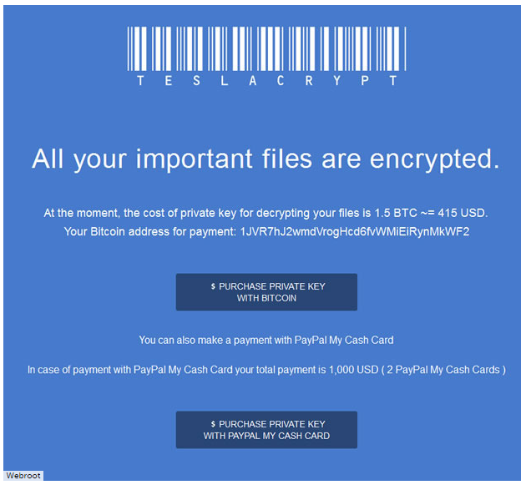

Slide 18
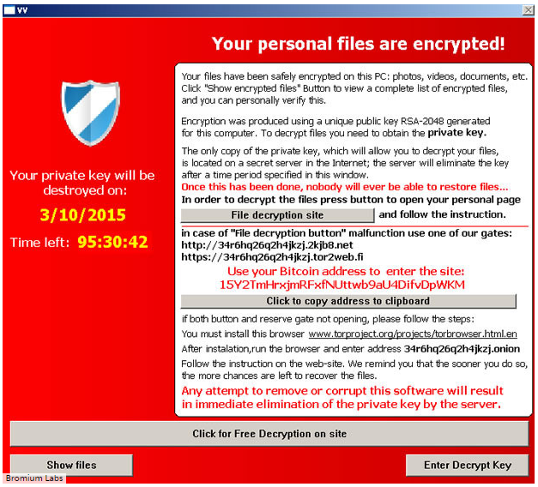

Slide 19
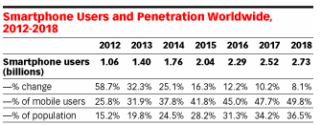
Worldwide Smartphone Usage

Slide 20
Internet of Things (IoT)
IoT - Network of networks of uniquely identifiable endpoints (“things”) that communicate without human interaction
IoT grow to 26 billion units to sales of $7.1 trillion in 2020
Enterprise: smart buildings with web-enabled technologies for managing heat, lighting, ventilation, elevators, security cameras
Home: smart TVs, webcams, smart home thermostats, remote power outlets, sprinkler controllers, doors locks, home alarms, bathroom scales, garage door openers, hubs for controlling multiple devices

Slide 21
Internet of Things (IoT)
7 of the 10 most popular types of IoT devices are vulnerable to attackers
Each device had average of 25 vulnerabilities (lack authentication, insecure web interface, lack of transport encryption)
Communications protocols for building automation and control networks, such as BACnet and LonTalk, are open and transparent
As embedded systems no means to update devices

Slide 22
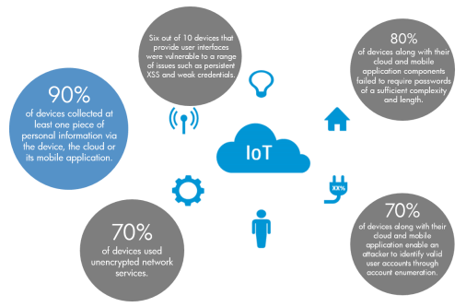

Slide 23
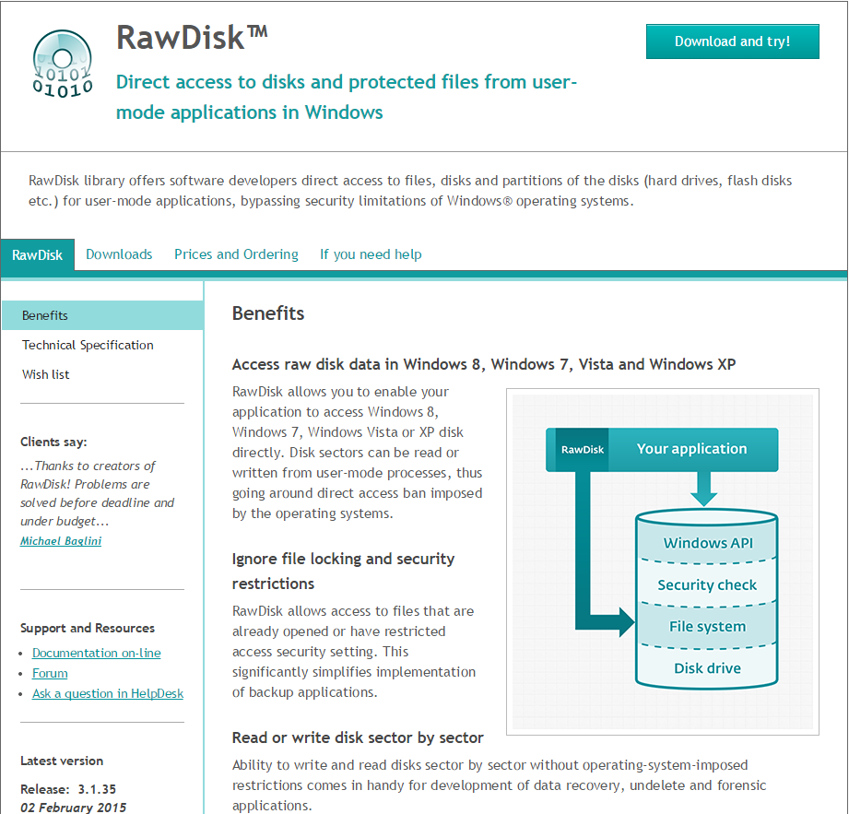

Slide 24
Your Privacy
Google Location History
Immersion
You’ve Been Pwned!

Slide 25
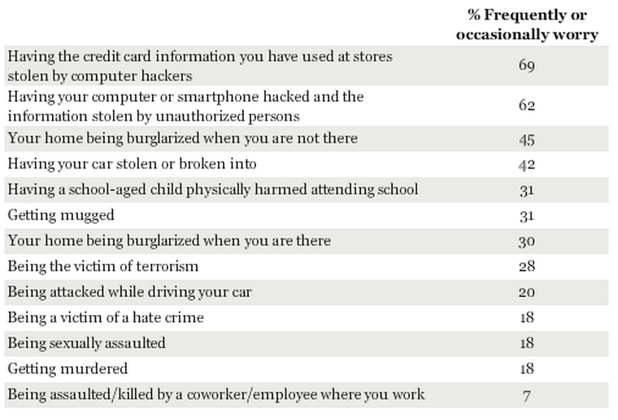
Crimes Americans Worry About Most

Slide 26
Above Average
Top 6 cities with computer infections above national average (per capita)
  Tampa
  Orlando
  St. Louis
  Salt Lake City
  Little Rock
  Washington, DC

Slide 27
Jan – Feb 2015
City/Region | Increase in Infections Last Month
New York City | 93%
Pennsylvania | 91%
New Jersey | 71%
Rhode Island | 55%
Maine | 53%
Massachusetts | 46%
Connecticut | 37%

Slide 28
Real Time Attack Trackers
FireEye Cyber Threat Map
Norse IPViking
Arbor Networks Digital Attack Map
Kaspersky Cyberthreat Real-time Map
Anubis Network Cyberfeed
F-Secure World Map
Trend Micro Global Botnet Threat Activity Map
Team Cymru Graphs
OpenDNS Global Network
Madiant IPew Attack
Alien Vault Global Dashboard

Slide 29
Cut Right To The Chase
Things are really bad in security
Users are still confused about security
Our students want to learn practical security
But schools are not teaching practical security
We can teach practical security in our Intro courses
Here’s how we can teach practical security

Slide 30
Users Are Still Confused
Survey of American, British and German adult computer users
40% not always update software on computers when they initially prompted
25% said do not clearly understand what software updates do
25% said do not understand the benefits of updating regularly
75% said saw update notifications but over half said needed to see notification between 2-5 times before decided
25% said do not know how to check if their software needs updating

Slide 31
Users Are Still Confused
88% use their home computer for online banking, stock trading, reviewing personal medical information, and storing financial information, health records, and resumes
98% agree important to be able to know risk level of a web site before visiting it (But 64% admit don’t know how to)
92% think that their anti-virus software is up to date (But only 51% have current anti-virus software that been updated within) last 7 days

Slide 32
Users Are Still Confused
44% don’t understand firewalls
25% have not even heard of the term “phishing” and only 13% can accurately define it
22% have anti-spyware software installed, an enabled firewall, and anti-virus protection that has been updated within last 7 days

Slide 33
Why Increase In Attacks
Speed of attacks
More sophisticated attacks
Simplicity of attack tools
Faster detection weaknesses
Delays in user patching
Distributed attacks
Attacks exploit user ignorance & confusion

Slide 34
User Confusion
Confusion over different attacks: Worm or virus? Adware or spyware? Rootkit or Trojan?
Confusion over different defenses: Antivirus? Firewall? Patches?
Users asked to make security decisions and perform technical procedures

Slide 35
Think Of a Typical User
Will you grant permission to open this port?
Is it safe to un-quarantine this attachment?
May I install this add-in?

Slide 36
User Misconceptions
I don’t have anything on my computer they want
I have antivirus software so I’m protected
The IT Department takes care of security here at school or work
My Apple computer is safe.

Slide 37
Cut Right To The Chase
Things are really bad in security
Users are still confused about security
Our students want to learn practical security
But schools are not teaching practical security
We can teach practical security in our Intro courses
Here’s how we can teach practical security

Slide 38
Students Want to Learn Security
Survey 679 students at both a Kentucky university and a North Carolina community college
First day of Introduction to Computers class
Students had received no instruction about security in class
Students had no previous computer courses at the school
Asked if specific security items were important to them

Slide 39
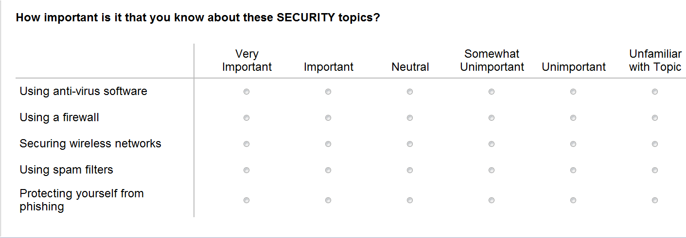
Students Want to Learn Security

Slide 40
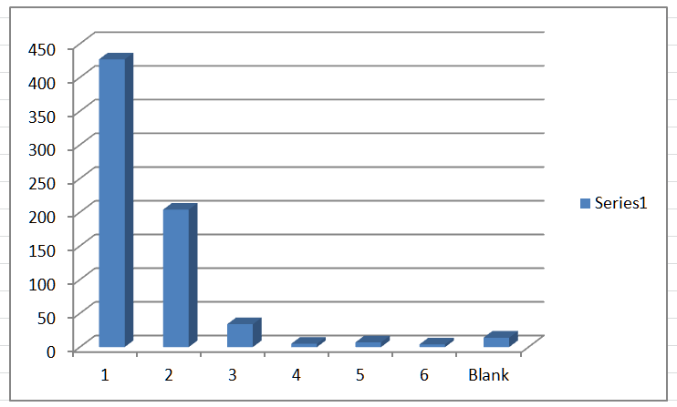
Anti-virus Software

Slide 41
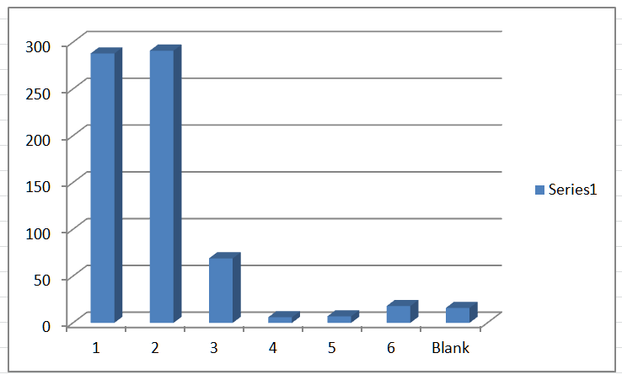
Using Firewall

Slide 42
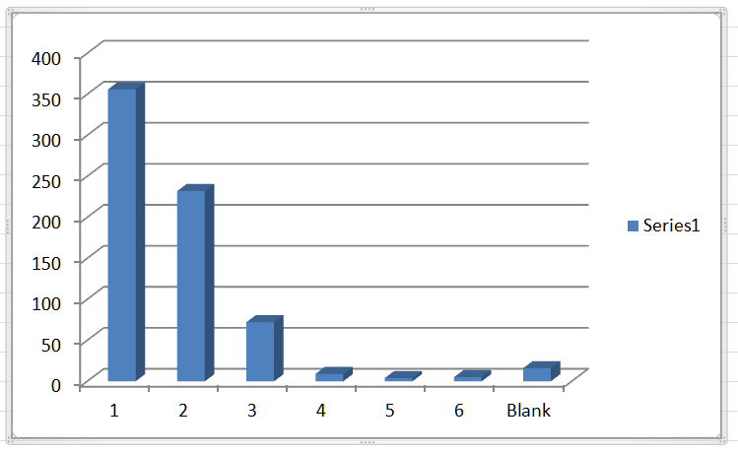
Securing Wireless

Slide 43
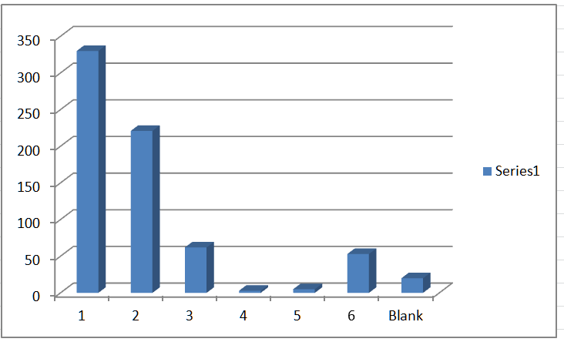
Protecting From Phishing

Slide 44
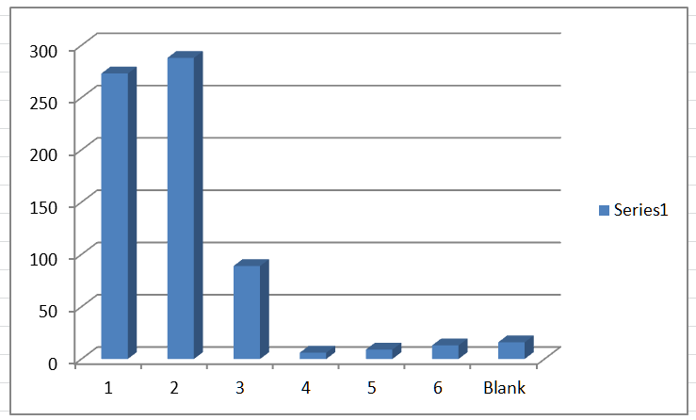
Using Spam Filters

Slide 45
Students Want To Learn Security
Who Said It | What They Want
Students Who Use and Know Technology | Create backups, configure web browser, create strong passwords
Students Who Own Computer | Scan for malware
Female Students | Scan for malware, create backups, use anti-virus, secure wireless networks

Slide 46
Cut Right To The Chase
Things are really bad in security
Users are still confused about security
Our students want to learn practical security
But schools are not teaching practical security
We can teach practical security in our Intro courses
Here’s how we can teach practical security

Slide 47
Security Education Today
Teach comprehensive enterprise security in CIS security track
Teach network security to CIS majors
Teach brief coverage of security definitions in Introduction to Computers to rest of students
Yet we are leaving out practical security awareness for all students

Slide 48
Calls for Vigilance
“Securing your home computer helps you and your family, and it also helps your nation . . . by reducing the risk to our financial system from theft, and to our nation from having your computer infected and then used as a tool to attack other computers”
Department Homeland Security

Slide 49
Calls for Awareness Training (Gov’t)
National Strategy to Secure Cyberspace (NSSC) document, created by U.S. President’s National Infrastructure Advisory Council, calls for comprehensive national security awareness program to empower all Americans, including the general population, “to secure their own parts of cyberspace”
Department of Homeland Security, through the NSSC, calls upon home users to help the nation secure cyberspace “by securing their own connections to it”

Slide 50
Calls for Awareness Training (Gov’t)
Action and Recommendation 3-4 of NSSC calls upon colleges and universities to model user awareness programs and materials
Colloquium for Information Systems Security Education (CISSE), International Federation of Information Processing Working Group 11.8 on Information Security Education (IFIP WISE), and Workshop on Education in Computer Security (WECS) all involved in security training in schools
Bipartisan Cybersecurity Enhancement Act would fund more cybersecurity research, awareness and education

Slide 51
Calls for Awareness Training
We need to invest in cyber education, and there’s no such thing as ‘too early’ when it comes to exposing our young people to [cybersecurity] and training them in this field – Rep. Jim Langevin, D-RI, congressional cybersecurity caucus co-chair & former member Homeland Security Committee
We want to educate everybody about the need for security and the basic construct of security . . . We are working to create a course that everybody can take and develop some basic understanding of cybersecurity – Program director Southeast Missouri State University

Slide 52
Calls for Awareness Training (Researchers)
Researchers state that institutions of higher education should be responsible for providing security awareness instruction, including Crowley (2003), Mangus (2002), Null (2004), Tobin and Ware (2005), Valentine (2005), Werner (2005), and Yang (2001)
Security instruction and training important not only to meet current demands of securing systems but also to prepare students for employment in their respective fields
Location of security awareness instruction and training in a college curriculum should not be isolated in upper-level courses for IT majors (Tobin and Ware, 2005; Werner, 2005)
Instruction should be taught to all graduates as a “security awareness” course (Valentine, 2005) along with integrating it across through the curriculum (Yang, 2001)
Long (1999) advocated that security instruction should begin as early as kindergarten

Slide 53
Cut Right To The Chase
Things are really bad in security
Users are still confused about security
Our students want to learn practical security
But schools are not teaching practical security
We can teach practical security in our Intro courses
Here’s how we can teach practical security

Slide 54
Security Education Challenge
Need educate all students about practical computer security in all of our courses
“Users should be as fluent with practical security as with using Word”
All our courses all use technology, so make security a “teaching moment”
Security Across the Curriculum

Slide 55
Teacher Pushback
Students don’t care about security
I don’t have time to teach it
I’m not a security expert so I can’t teach it

Slide 56
‘I Don’t Have Time to Teach It’
Is there a skill that is more important and more useful than practical security today?
We can also take the opportunity to introduce security as we cover specific topics (“teaching moment”)
For example, when we ask them to research using the Internet then spend 10 minutes that day talking about Internet security

Slide 57
Experts Not Needed
Security experts are not wanted!
Often security experts get too carried away with too many details!
Need teach basic practical security skills and not advanced security topics

Slide 58
Cut Right To The Chase
Things are really bad in security
Users are still confused about security
Our students want to learn practical security
But schools are not teaching practical security
We can teach practical security in our Intro courses
Here’s how we can teach practical security

Slide 59
How To Teach Security
 | Practical Security | Intro to Computers textbook security
Topics | Personal, computer, Internet, mobile | Security devices
Focus | End user | Enterprise
Emphasis | Defense | How it works
Devices | Desktop, laptop, smartphone | Mainframe, servers
Approach | How protect yourself | Teach definitions

Slide 60
Practical Security Topics
Personal | Computer | Internet | Mobile
Passwords | Malware types | Browser settings | Wi-Fi risks
Phishing | Patches | Digital certificates | Bluetooth risks
Social networks | Anti-virus | Hyperlinks | Wireless defenses
 | Firewalls |  | Public Wi-Fi
 | UAC
 | Backups

Slide 61
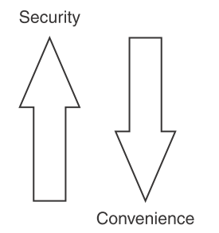
How To Teach Security

Slide 62
Which Is Better?
thisisaverylongpassword
Xp4!e%
Length always trumps complexity

Slide 63
Length Over Complexity
Keyboard had only 3 keys: A, B, and C
Had to create a 2-character password
How many different passwords could we create?
What’s the relationship between those numbers?

Slide 64
Length Over Complexity
Number-of-Keyboard-Keys ^ Password-Length = Total-Number-of-Possible-Passwords
Keyboard Keys | Password Length | Possible Passwords
80 | 2 | 6,400
80 | 3 | 512,000
80 | 4 | 4,096,000
80 | 5 | 3,276,800,000
80 | 8 | 1,677,721,600,000,000

Slide 65
Length Over Complexity
How Secure Is My Password
Password Strength Calculator
Haystack
Password Meter

Slide 66
Password Problems
Effective passwords are long and complex, but these are difficult to memorize and then accurately recall
Users must remember passwords for many different accounts (different computers and mobile devices at work, school, and home; multiple email accounts; online banking; Internet site accounts, etc.)
Many security policies have that passwords expire after a set period of time when new one must be created
Some security policies even prevent a previously used password from being recycled and used again, forcing users to repeatedly memorize new passwords

Slide 67
Weak Passwords
Common word (Eagles)
Short passwords (ABCDEF)
Personal information (name of a child or pet)
Write password down
Predictable use of characters
Not change password
Reuse same password

Slide 68
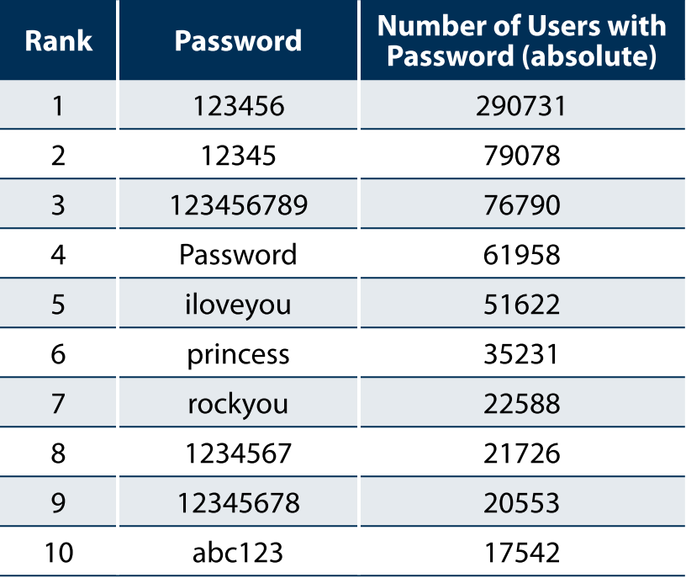
Top 10 Passwords

Slide 69
Top Password Lists
14% users have a password from the Top 10 passwords
40% users have a password from the Top 100 passwords
79% users have a password from the Top 500 passwords
91% users have a password from the Top 1000 password

Slide 70
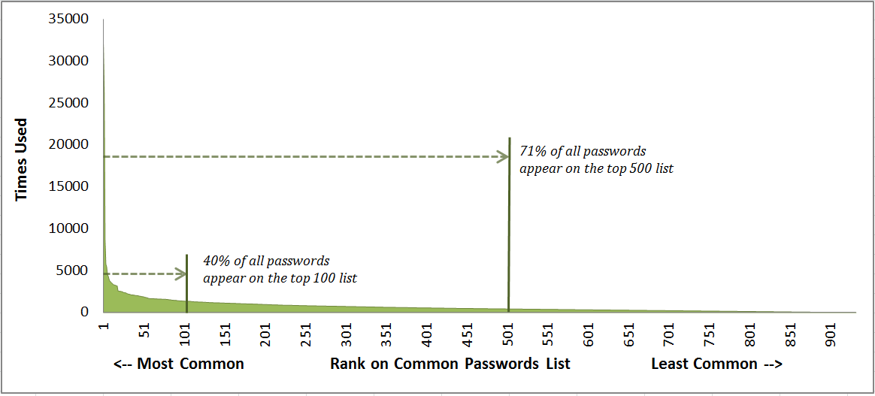
Top 10 Passwords

Slide 71
Useless User Tricks - 1
Even when users attempt to create stronger passwords, they generally follow predictable patterns
Appending - Typically only add a number after letters (caitlin1 or cheer99); if they add all more it in sequence letters+punctuation+number (amanda.7 or chris#6).
Replacing – A zero is used instead of the letter o (passw0rd), the digit 1 for the letter i (denn1s), or a dollar sign for an s (be$tfriend).
Attackers are aware of these patterns in passwords and can search for them, dramatically weakening passwords and make it easier for attackers to crack them.

Slide 72
Useless User Tricks - 2
Take the first letter of the site’s name in lower case (Gmail.com -> g)
Add the last two digits of your birth year but reverse them (1993 -> 93 -> 39)
Add a +
Add the next four letters of the site’s name in upper case ("gmail.com" -> MAIL)
Add a -
Add the last four digits of your phone number backwards (877-555-1234 -> 4321)
Your new secure password is g93+MAIL-4321 : SECURE!
Your new secure password is y93+AHOO-4321 : NOT SECURE

Slide 73
Useless User Tricks - 3
The Qwerty Card is a simple plastic card laid out like a Qwerty keyboard and also has a unique code like sh(/J3Hq.
You add your own secret password (shine) to the code and then append the encoded version of the site’s name using the character map on the card
Amazon becomes .u.rqf which is added to the previous strings to generate the complete password sh(/J3Hqshine.u.rqf

Slide 74
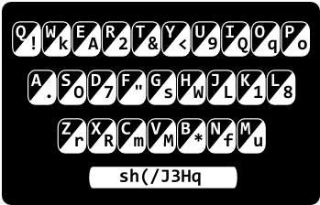
Useless User Tricks - 3
Spacebar code + Secret word + Site name

Slide 75
What Attackers Do
Attackers do not guess at passwords
Use technology: brute force, dictionary, hybrid, rainbow tables
Recent attack used a computer that tried more than 300 billion plaintext guesses every second
Today attackers use stolen password files to determine how users think about creating passwords and use common passwords as candidates

Slide 76
Password Survey
1,000 non-IT workers, half from US and half from UK
Only 37% of survey participants use passwords that contain both letters and numbers
73% report that they allow their browser to remember passwords for them at least some of the time
42% of survey participants say they write passwords down to keep track of them
74% log into 6+ sites daily and 30% visit 10+ sites; but 59% of participants say they use five or fewer passwords (meaning they use the same password on multiple sites)

Slide 77
Password Principles
Any password that can be memorized is a weak password
Any password that is repeated is a weak password
Use technology instead of brain

Slide 78
Password Management Application
Password management application – Allow user to store username and password, along with other account details
Application is itself protected by a single strong password, and can even require the presence of a file on a USB flash drive before the program will open
Allows user to retrieve usernames and passwords without the need to remember or even type them
Allows for very strong passwords:

Slide 79
My Password
ÞtqâGøÑÆ»¬ñB±.Û©¸ùÏ\"$@mgÉ\

Slide 80
Password Management Application
In-memory protection - Passwords are encrypted while the application is running to conceal passwords
Key files - In order to open the password database key file must also be present
Lock to user account - The database can be locked so that it can only be opened by the same person who created it
Password groupings - User passwords can be arranged as a tree, so that a group can have subgroups
Random password generator - A built-in random password generator can create strong random passwords based on different settings!
Only 8% use password management application

Slide 81
Password Management Application
Dashlane
LastPass
KeePass
1Password
Blur
PasswordBox
RoboForm
StickyPassword

Slide 82
KeePass

Slide 83
If You Rely On Memory Only
Do not use passwords that consist of dictionary words or phonetic words
Do not use birthdays, family member names, pet names, addresses, or any personal information
Do not repeat characters (xxx) or use sequences (abc, 123, qwerty)
Minimum of 12 characters in length or for accounts that require higher security a minimum of 18 characters is recommended
Consider using a longer passphrase but not in normal English sequence: not theraininspainfallsmainlyontheplain but instead use in sequence mainlyinonthethespainrainfalls
Use nonkeyboard characters
Length is more important than complexity

Slide 84
Use Nonkeyboard Characters
Make passwords stronger with special characters not on keyboard
Created by holding down ALT key while simultaneously typing a number on numeric keypad (but not the numbers across the top of the keyboard); ALT + 0163 produces £.
To see a list of all the available non-keyboard characters click Start and Run and enter charmap.exe; click on character and the code ALT + 0xxx will appear in lower-right corner if can be reproduced in Windows

Slide 85
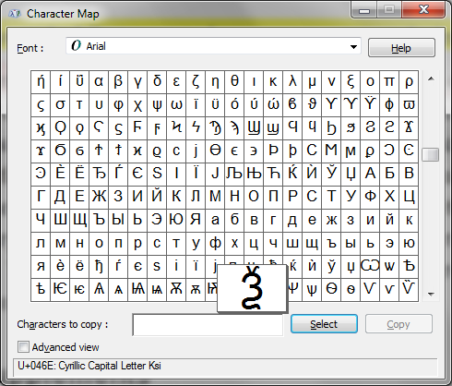

Slide 86
Phishing
Social engineering - Relies on deceiving someone to obtain secure information
Phishing - Common form of social engineering is sending an e-mail or displaying a Web announcement that falsely claims to be from a legitimate enterprise in an attempt to trick the user into surrendering private information
User asked respond to an e-mail or is directed to a Web site where instructed to update personal information, such as passwords, credit card numbers, Social Security numbers, bank account numbers, or other information for which the legitimate organization already has a record
However, Web site is actually a fake and is set up to steal the user’s information

Slide 87
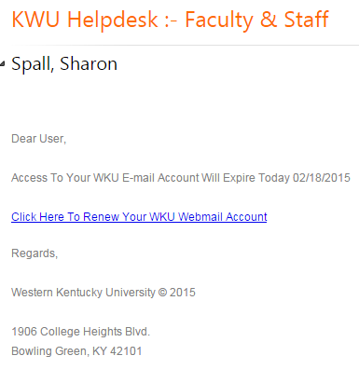

Slide 88
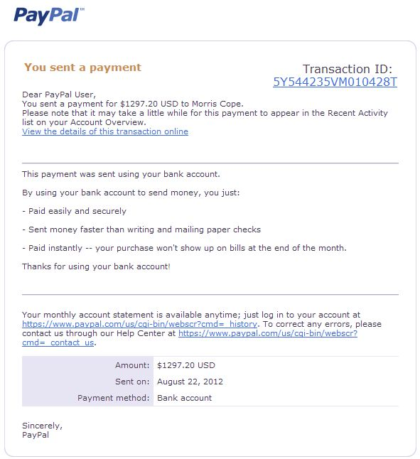

Slide 89
Embedded Hyperlink

Slide 90
Embedded Hyperlink
. . . you can <a href="http://www.capitalone.com">log in to Online Account Services (OAS) </a> from this e-mail
. . . you can <a href="http://www.steal-your-number.net">log in to Online Account Services (OAS) </a> from this e-mail

Slide 91
Good Advice, Bad Practice
“It is never advisable to login to a website that you reached from a link in an email. It is far better to type the address into a browser and then login. You can find additional tips for spotting phishing at http://www.wku.edu/it/security/sc-phishing.php”

Slide 92
Phishing Tests
Mailfrontier
Antiphishing.org
Antiphishing Phil
Paypal

Slide 93
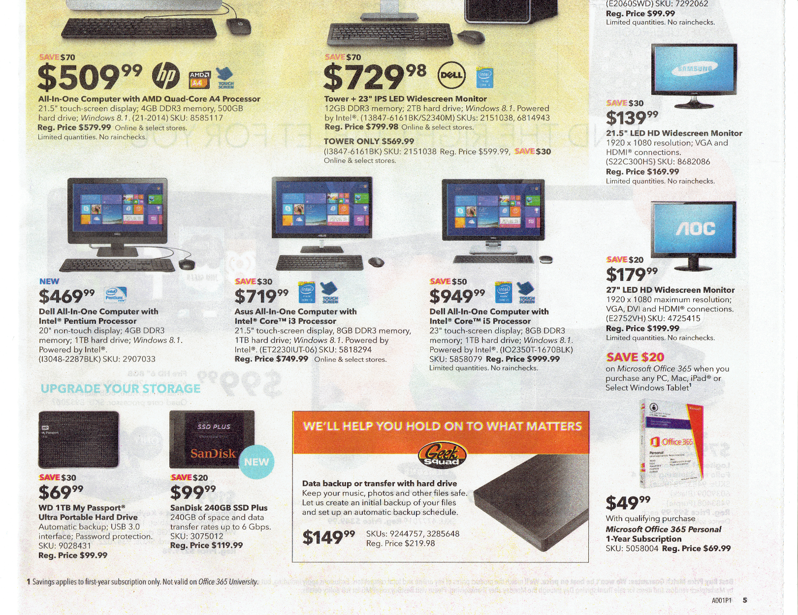

Slide 94
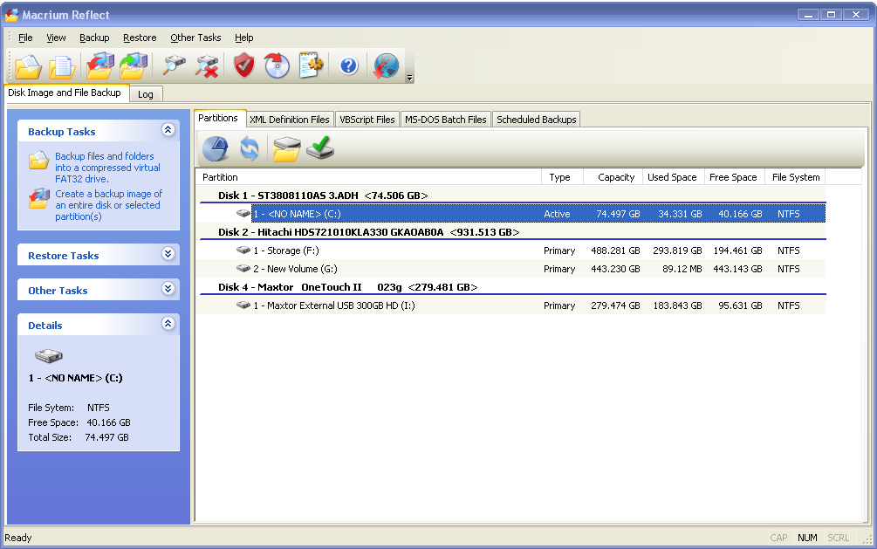
Backups

Slide 95
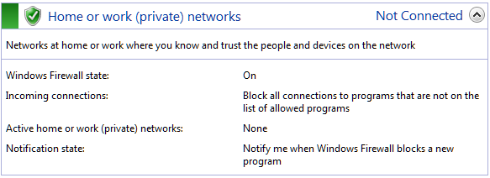
Check Firewall Settings

Slide 96
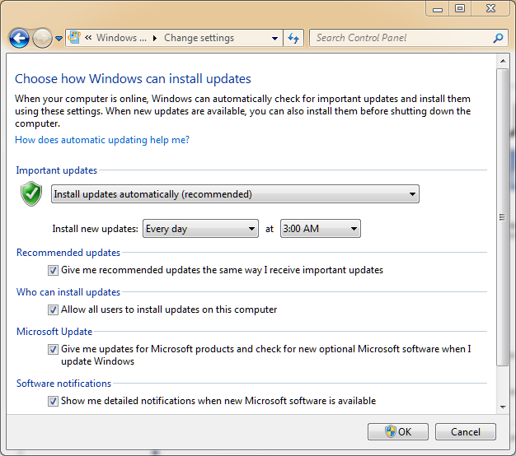
Patch Management

Slide 97
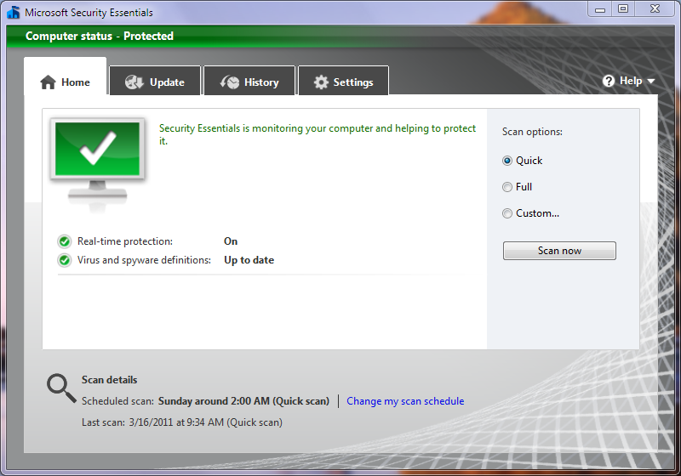
Antivirus

Slide 98
Antivirus
Test antivirus settings
Disinfect
Malware scanner
Secunia Software Inspector

Slide 99
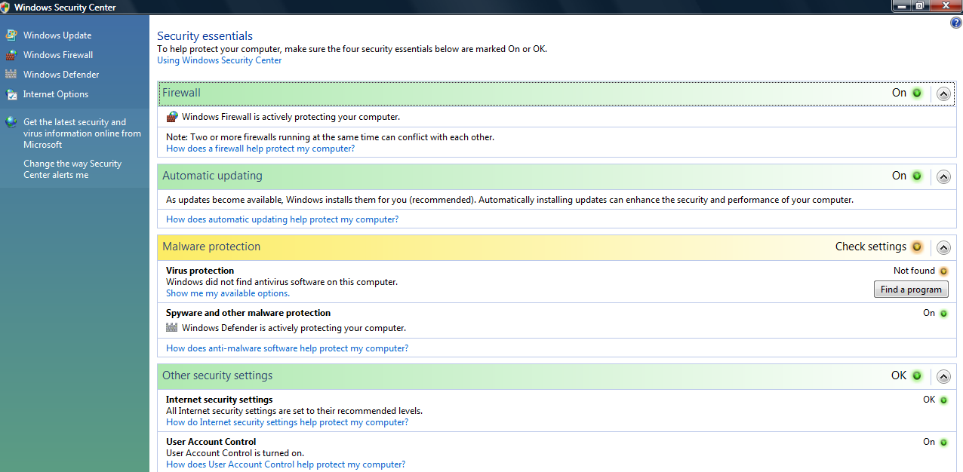
Windows Action Center

Slide 100
User Account Control (UAC)
User attempts to perform task that requires administrative access then prompted for approval or administrator password if standard user
Displays authentication dialog box must be answered before continuing
  Administrators - Click Continue or Cancel
  Standard users - Enter admin password

Slide 101
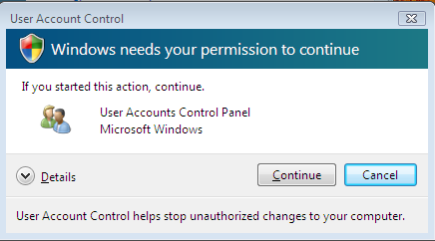
User Account Control (UAC)

Slide 102
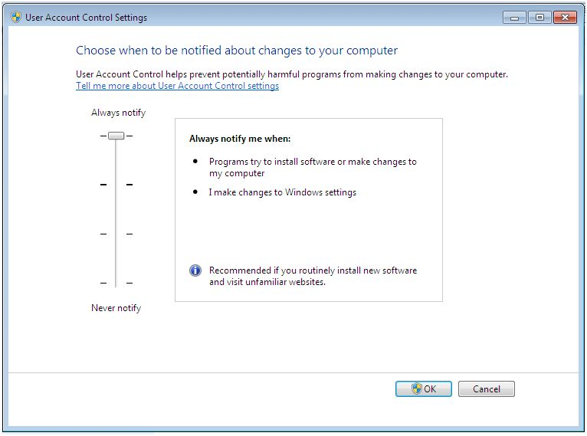
User Account Control (UAC)

Slide 103
Using Public Wi-Fi
Limit type of work (not online banking or sending confidential information)
Use sites that have digital certificates (encrypts all transmissions)

Slide 104
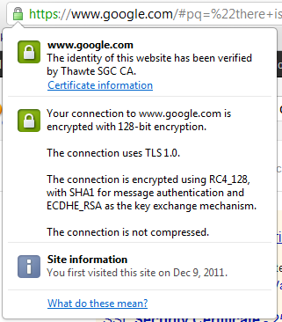
Understand Certificates

Slide 105




Understand Indicators
No secure connection so don’t enter sensitive information, such as usernames and passwords
Successfully established a secure connection with the site
Detected insecure content on the page; be careful entering sensitive information
Detected either high-risk insecure content on the page or problems with the site’s certificate; don’t enter sensitive information

Slide 106
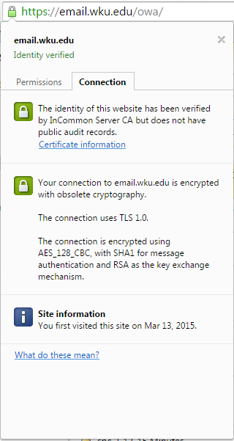
Security Person’s Approach

Slide 107
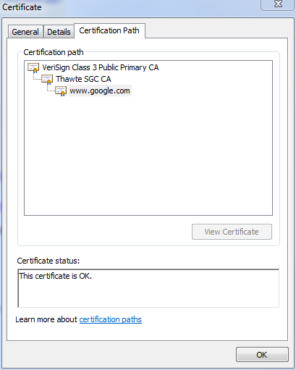
Security Person’s Approach

Slide 108
Security Person’s Approach
Confusing Names: "certificate“, "HTTPS certificate“, “encryption certificate“, "security certificate“
Any Certificate Authority (CA) can vouch for any website
Hundreds of CAs and each has sub-contractors also issue certificates: who are GeoTrust, Entrust, USERTrust, GTE CyberTrust, Starfield, CertPlus, DigiCert, Thawte—and Hong Kong Post Office is a trusted Certificate Authority!
Firefox, Chrome, IE, Opera, Vivaldi, Safari all have different ways to view certificates

Slide 109
Asymmetric Cryptographic Algorithms
Weakness of symmetric algorithms: distributing and maintaining a secure single key among multiple users distributed geographically
Asymmetric cryptographic algorithms (public key cryptography) - Uses two keys instead of only one
Keys are mathematically related:
  Public key - Known to everyone and can be freely distributed
  Private key - Known only to the individual to whom it belongs

Slide 110
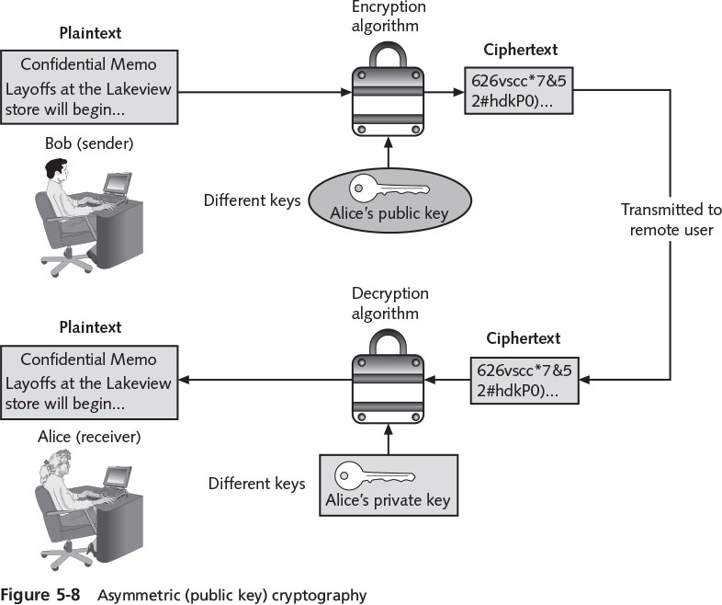
Asymmetric (Public Key) Cryptography

Slide 111
Asymmetric Cryptographic Algorithm Principles
Important principles
  Key pairs – Requires pair of keys
  Public key – Do not need to be protected
  Private key – Must be kept confidential
  Both directions - Document encrypted with public key can be decrypted with corresponding private key (and document encrypted with private key can be decrypted with public key)

Slide 112
Duties of CA
Duties of CA:
  Generate, issue, an distribute public key certificates
  Distribute CA certificates
  Generate and publish certificate status information
  Provide a means for subscribers to request revocation
  Revoke public-key certificates
  Maintain security, availability, and continuity of certificate issuance signing functions.

Slide 113
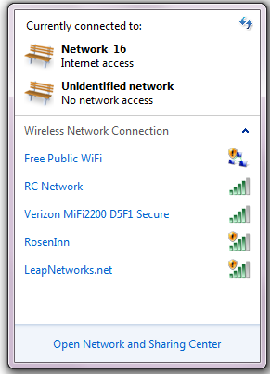
Beware of Imposters

Slide 114
Using Public Wi-Fi
Do not set to automatically connect
Beware of imposters
Don’t use for sensitive data

Slide 115
What About My Home Wireless?
Get into any folder set with file sharing enabled
See wireless transmissions
Access network behind firewall can inject malware
Download harmful content linked to unsuspecting owner

Slide 116
1. Lock Down Device
Create strong Password (over 15 characters)
Disable Remote Management (cannot access settings via Internet)

Slide 117
2. Turn on WPA2
On wireless router set WPA2 Personal
WPA2 Personal security option, which may be labeled as WPA2-PSK [AES], is turned on by clicking the appropriate option button
A key value, sometimes called a preshared key (PSK), WPA2 shared key, or passphrase, must be entered; this key value can be from 8 to 63 characters in length

Slide 118
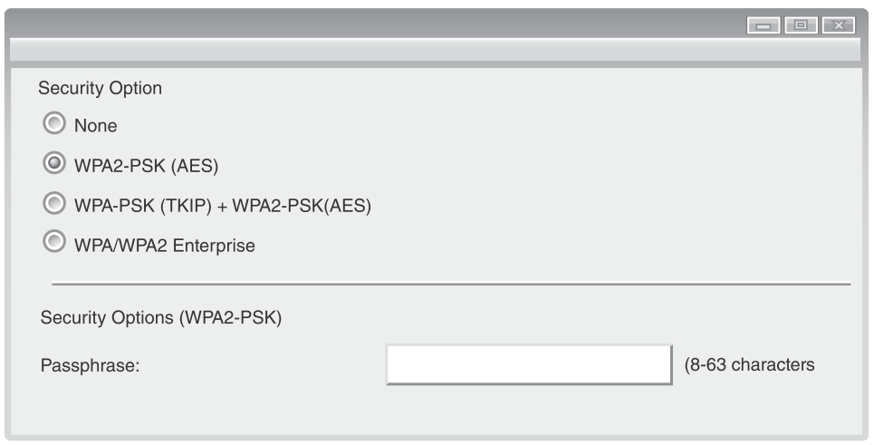

Slide 119
2. Turn on WPA2
After turning on WPA2 Personal on wireless router and entering a key value, the same key value must also be entered on each mobile device that has permission to access the Wi-Fi network
A mobile device that attempts to access a wireless network with WPA2 Personal will automatically ask for the key value
Once the key value is entered, the mobile device can retain the value and does need to ask for it again

Slide 120
Social Networking Attacks
Grouping individuals and organizations into clusters or groups based on affiliation called social networking
Web sites that facilitate linking individuals with common interests like hobbies, religion, politics, or school contacts are called social networking sites and function as an online community of users
User who is granted access to a social networking site can read the profile pages of other members and interact with them
Social networking sites increasingly becoming prime targets of attacks

Slide 121
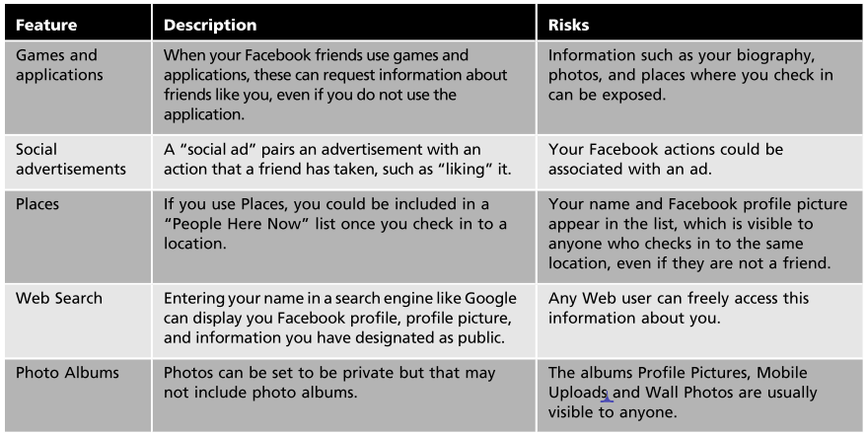

Slide 122
Social Network Defenses
Consider carefully who is accepted as a friend – Once person has been accepted as friend that person will be able to access any personal information or photographs
Show "limited friends" a reduced version of your profile - Individuals can be designated “limited friends” who only have access to a smaller version of the user’s profile
Disable options and then reopen them only as necessary - Disable options until it becomes apparent that option is needed, instead of making everything accessible and restricting access later after it is too late

Slide 123
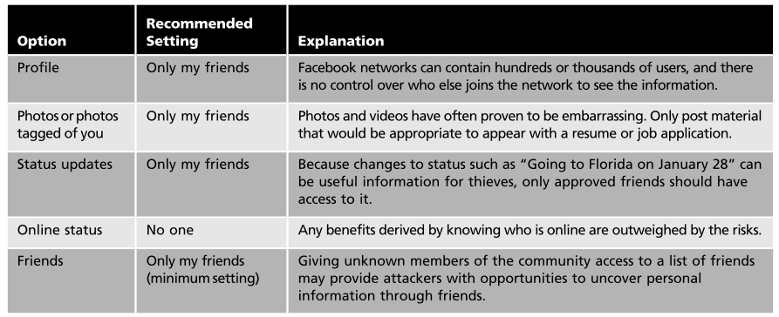

Slide 124
New Approaches
“Security Across the Curriculum”
Adding practical security to Introduction to Computers course
Content added to freshman orientation course
Substitute practical security course for advanced Office applications course
Adding 1 hour ethics & practical security course

Slide 125
Student Comments
As for the material presented in this class, it is great. I have found all the hands on projects to be very useful. I would recommend this class to all students. Very useful!
I have to say that I was dreading this course because I am definitely not a "techie", but I have been surprised by how much I have enjoyed it so far. I love the hands on projects!
Your class is interesting, informative, and would help anyone learn about what threats are out there, and what needs to be done to secure their system.
I'm actually having an awesome time with this class. It's kind of making me question switching my major to something more involved in the field of computer technology.

Slide 126
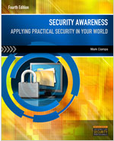
Security Awareness 4e
Security Awareness: Applying Practical Security in Your World, 4e
Basic introduction to practical computer security for all users, from students to home users to business professionals

Slide 127
Adding Practical Security to Your
Introduction to Computers Course (or CTI 120)
Mark Ciampa
Western Kentucky University
mark.ciampa@wku.edu

