Slide 1
Mock Forensics Crime Scene Investigation utilizing the Chain of Custody.
Francisco Salinas South Texas College
Dr Deanne Wesley Forsyth Technical Community College

Slide 2
Workshop Objectives

Slide 3
Processing the Crime Scene

Slide 4
Chain of Custody Form
Purpose: To document the evidence that was collected.
*The evidence must be reliable

Slide 5
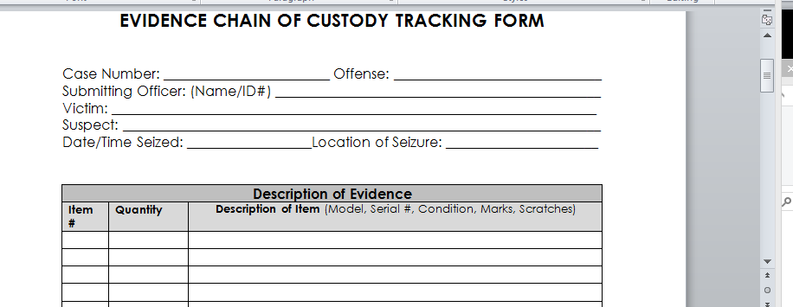
Sample Chain of Custody Form

Slide 6
Digital Forensic Tools
There are multiple tools in the industry available to Digital Forensic Examiners:
Name of Tool Company Name Web URL
Backlight Black Bag Technologies www.blackbagtech.com
P2C / DS Paraben Corporation www.paraben.com
Encase Guidance Software www.guidancesoftware.com
Forensic Toolkit (FTK) Access Data www.accessdata.com
Cellebrite Cellebrite www.cellebrite.com
IEF Magnet Forensics www.magnetforensics.com
SANS DFIR SANS http://digital-forensics.sans.org/
OS Forensic Pass Mark http://www.osforensics.com/osforensics.html

Slide 7
Pulling the Plug on a Live System?
Not a good idea anymore.
Much information gets loaded into RAM
Malware
Pictures
Passwords
Proprietary and Open Source tools can utilized to acquire RAM and Pagefile.sys
Running Processes can be collected from a live machine

Slide 8
Collecting RAM from a Live Machine
Physical Memory vs. Virtual Memory
Random Access Memory is faster
Virtual Memory is slower (stored on the hard disk)
Pagefile.sys stored on the root of the C drive

Slide 9
RAM Capture Tools
FTK Imager Access Data www.accessdata.com
SiQuest Memory Imager SiQuest www.siquest.com
Magnet RAM Capture Magnet Forensics www.magnetforensics.com
OSForensics Memory Viewer Passmark Software www.osforensics.com
Belkasoft Live RAM Capturer Belkasoft www.belkasoft.com/ram/download

Slide 10
Disk Imaging Tools
FTK Imager Access Data www.accessdata.com
Forensic Replicator Paraben www.paraben.com
Tableau Imager Tableau (you need a write hardware write-blocker)

Slide 11
Hardware or Software Write-Blockers
Hardware Write-Blockers
Tableau sells different modules (USB, SATA, IDE, Firewire, SAS, Card Readers)
No need for extra special adapters
Software Write-Blockers
Less expensive
No need to carry any hardware to the crime scene
May get corrupted

Slide 12
Clone Drive or Software Image
Hardware Forensic Duplicator
Clone a suspect drive to another physical drive
Make sure to obtain at least two clone drives
The sooner the better. Do not use the original suspect drive during the analysis
Cost is about $1,600
Software Imaging Tools
FTK Imager (free)
Know your tools (Use adequate format supported by your forensic analysis tools)

Slide 13
Case Scenario
Demonstration

Slide 14
Managing Case Evidence

Slide 15
BlackLight Case Manager

Slide 16
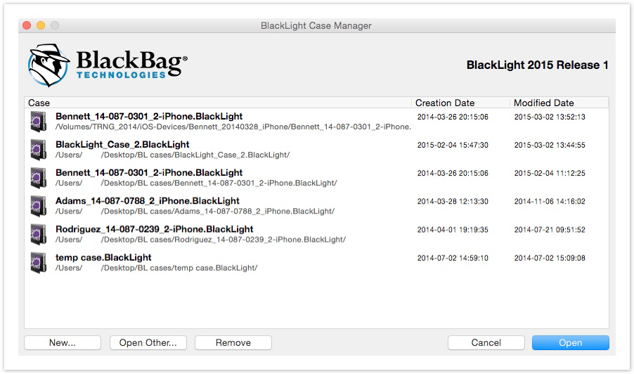
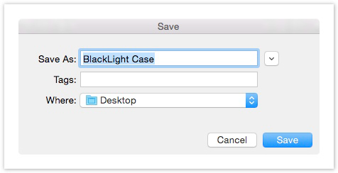
Starting a New Case
To create a new case, select the New... button. A ‘Save’ dialog window appears.
Navigate to the location where case files are saved and select the Save button to save the new case and begin working with BlackLight.

Slide 17
The Case Info
When a case file is opened, the ‘Case Info’ screen appears. Input examiner and case information here.
(An examiner can change/add to this information at any time during an examination.)
Once an examiner creates a case on their analysis machine and populates the 'Examiner Information‘ fields, these fields are populated automatically thereafter.
However, an examiner must populate 'Case Information' fields manually each time he/she creates a new case.

Slide 18
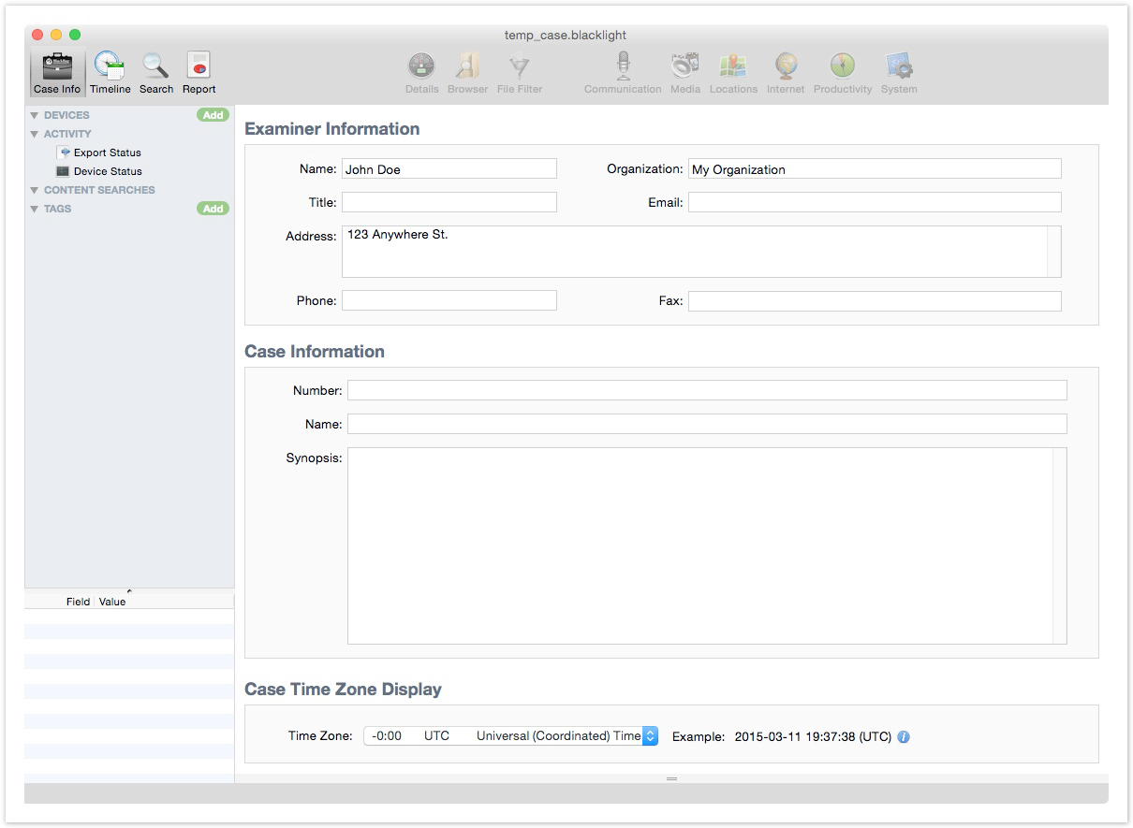
The Case Info

Slide 19
BlackLight Time Zone Settings
By default, BlackLight displays timestamps as Universal Coordinated Time (UTC). Dates and times are displayed with the selected time zone appearing in parentheses: 2009-12-19 19:34:51 (PST).
After case information is complete, begin adding evidence to case file.
Quick Tip: Case Files
A BlackLight case file is actually a ‘package’ file on a Mac, and a folder on a Windows system. All case elements are stored in this package file or folder, so a case file can grow rather large depending on how big a case is. Before creating a new case, make sure there is plenty of storage space on the working hard drive.

Slide 20
Adding Evidence to the Case
There are three ways to add evidence files to a BlackLight case
from the ‘Component List
from the [File] menu
via drag and drop.
Select the [File] menu and select one of the [Add...] submenu options or, in the ‘Component List’ to the right of ‘Evidence,’ select the green Add button.
A menu similar to the [File] => [Add...] submenu option is displayed.

Slide 21
Disk Image Formats
RAW Image (DD) Most Forensic Programs
Disk Image (DMG) MacQuisition™, Converted DD images
EnCase® (EWF-E01), (EWF-L01) EnCase (all versions), FTK Imager®
SMART (EWF-S01) ASR Smart
Virtual Machine Disks (VMDK) VMware®

Slide 22
iOS Image Formats
JZ (all versions) Jonathan Zdziarski Tools
iXAM® (2.3.9 and higher) Forensic Telecommunications Services
MPE+ (4.0 and higher)
Cellebrite UFED
Cellebrite Logical Images created via iOS backup archive
Cellebrite Logical Images created via logical filesystem dump
iOS Forensic Toolkit (1.04 and higher) ElcomSoft
iPhone-Dataprotect / Lantern Lite Katana Forensics

Slide 23
Adding Evidence to the Case

Slide 24
Adding a Disk Image
Select the [File ] menu, or in the top right corner of the ‘Component List,’ select the green Add button and choose [Add Disk Image...]. An 'Open' window appears. Navigate to a disk image and select the Open button. An ‘Evidence Selection’ window appears.

Slide 25
Unallocated Space
By default, BlackLight attempts to recover all listed file types, and this may take some time.
At the bottom of the ‘Evidence Selection’ window, activate the Locate Files checkbox, and select the Settings button to specify the unallocated file types to include in the recovery.

Slide 26
Processing Options
Signature Analysis Compare file headers to file extensions to see if they match
Process Pictures Identify images using signature analysis
Process Videos Parse videos and split them into sixteen frame sequences (4 x 4) to allow BlackLight gallery view and % skin tone analysis
Calculate File Hashes Hash all files using MD5, SHA-1 and SHA-256 algorithms
Identify Known Files Identify known file types using Known File Hash [KFH] databases
Locate Files Recover or attempt to recover deleted files

Slide 27
Enter an Evidence ID
In the ‘Evidence Selection’ window, select the <Click to Edit> label. Enter an Evidence ID (e.g., the evidence ID on an evidence bag) if desired.
This input is visible in the Evidence ID column.
Note: Evidence IDs identify the device, NOT a device partition.

Slide 28
Run Pending Processes
To run previously-skipped file processing options at any time, in the ‘Component List’ under ‘Activity,’ select ‘Evidence Status.’
A Run button appears under the processing options that have yet to execute.

Slide 29
Hash Sets
The ‘Hash Sets’ window allows an examiner to choose which hash sets BlackLight should use to identify known and notable file types.
BlackLight ships with the Known OS X System Files hash set, the Hashkeeper hash sets and the Apple NSRL 2.44 hash set database.
Note: The NSRL 2.44 hash set that ships with BlackLight is a subset of the full NSRL hash set database. It currently includes ONLY hash values identified for Apple-based products.

Slide 30
Additional Hash Sets
Additionally, BlackLight recognizes Encase (6.19 and lower), NSRL (full), and BlackLight (.blhs) hash set formats.
BlackLight also imports hash sets saved as text files as long as the file contains one hash value per line with each line separated by a carriage return.
Custom hash sets created in BlackLight are automatically saved in the blhs format and are available for use in all BlackLight cases.

Slide 31
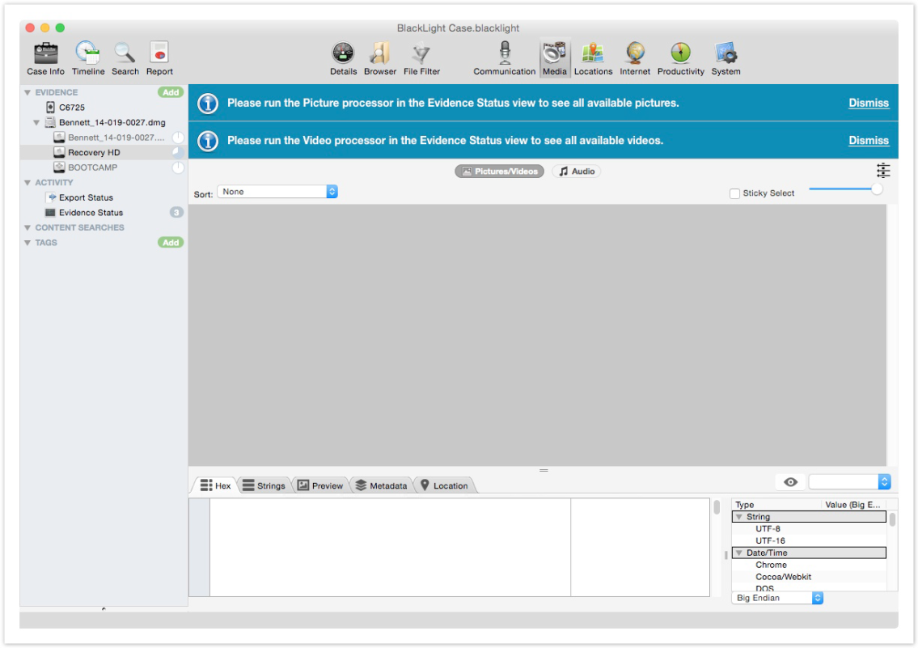
Processing the Evidence
While a partition is in the 'Optimizing' process, the examiner can begin browsing data in various views, though it must be remembered that not all data is available to view until processing is complete.
Banners appear at the top of the 'Content Pane' to remind the examiner that the picture and video processors must be run before all picture and video files can be viewed.

Slide 32
Run Pending Processes
To run previously-skipped file processing options at any time, in the ‘Component List’ under ‘Activity,’ select ‘Evidence Status.’
A Run button appears under the processing options that have yet to execute.

Slide 33
Filtering
Filtering helps save time when looking for specific evidence.
BlackLight can filter data based on different criteria

Slide 34
Geolocation
Helps identify where images were taken.
Can be viewed in Google Maps
Can be exported and viewed in Google Earth

Slide 35
Write the Report
Investigative Report can be generated in different formats.
HTML
PDF
DOCX
Text
Forensic Examiner may decide to print all Report Elements or only certain elements to present as evidence.

Slide 36
Careers in Forensics
Forensic Scientist
Criminologist
Crime Scene Investigation
Cyber Analyst
Forensic Science Analyst
Latent Print Examiner
Digital Forensic Investigator
E-Discovery Investigator

Slide 37
Industry Certifications Benefits
Each company provides their own certification programs:
Employers look for industry certifications and formal education
It helps when you are an expert witness in a court of law
Mastering multiple tools provides more opportunities
Some specialize in mobile forensics, others in computer forensics

Slide 38
Industry Certifications
Each company provides their own certification programs:
Certified Computer Examiner
Computer Hacking Forensic Investigator
Certified Forensic Computer Examiner
Cyber Security Forensic Examiner

Slide 39
Thank You Contact Deanne Wesley dwesley@forsythtech.edu Francisco Salinas fsalinas@southtexascollege.edu

